Slide 1
Early Restoration In America

Slide 2
Reasons To Study Church History
Helps Us Learn From The Mistakes Of The Past And Avoid Them
To Build Upon Their Successes, So We Can Grow From Them
Helps Us Appreciate The Lord’s Church

Slide 3
Movements Independent Of Campbell & Stone
To Some Campbell & Stone Are Credited With Beginning Restoration
Some Predate These Men In Restoring New Testament Christianity
The Religious Freedom That This Country Was Built On Allowed Anyone With A Bible To Search The Scriptures And Obey Them

Slide 4
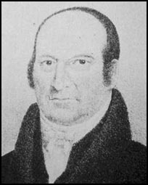
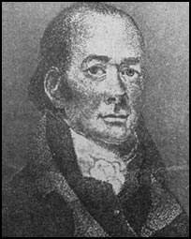
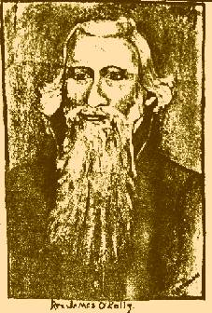
Earliest Restorers
Abner Jones
Elias Smith
1772-1841
1769-1846
John Wright
James O'Kelley
1738-1826
1785-1851

Slide 5
New England
Elias Smith
Born In Lyme, Connecticut, June 17, 1769
His Father Was Baptist & Mother A Congregationalist
At 8yrs. Sprinkled
Broke With Sandamanian Congregationalists In New England
1789 Immersed A Baptist
Went Into Universalism Three Times Over The Course Of His Life
Gave It Up By 1826
1802 – Taught That We Should Be Only Christians
1769-1846

Slide 6
Elias Smith
Began Journal In 1808 –Herald Of Gospel Liberty, Later Called The Gospel Proclaimer
1810 – Started Christian Church Woodstock, VT
360 Baptisms Within A Short Time
Met In Woodstock Courthouse
Never Heard Of Campbell Or Stone

Slide 7
New England
Moved From Mass. When He Was 8 Yrs. Old To Vermont
1793 Baptized Into Baptist Church, Woodstock, VT
Began To Preach 1801, Age 29
Began Planning At 21
Studied His Bible On His Own
Found Baptist To Be Unauthorized Name
Should Be A Christian Only
Organized 1st Free Christian Church In New England
Denied Calvinism And Branded As Heretic By Free-Will Baptists
Abner Jones
1772-1841
Studied And Practiced Medicine For Many Years
Mastered Hebrew, Latin & Greek Grammars
Started Christian Churches In Vermont, New Hampshire & Salem, Massachusetts

Slide 8
James O’Kelley
Born In Ireland
Moved To America At A Young Age
Fell Under Influence Of Methodist Episcopal Church
Ordained A Methodist Preacher And Circuit Rider
O’Kelley’s Concerns
Didn’t Like One Man Being Placed Over The Church
Thought Circuit Riders Should Go Where They Felt The Need
James O'Kelley
1738-1826

Slide 9
O’Kelley Leaves Methodism
By 1792 – Other Than Francis Asbury, O’Kelley Was Probably The Most Influential Preacher Among Methodists
In 1789 – He Had Written Essays On Negro Slavery
He Was A Personal Friend To Thomas Jefferson
Had Addressed & Preached Before The U.S. Congress
December 24, 1792 – Awkward Conference Of Methodist – Made Two Suggestions
If Circuit Riders Did Not Like Their Assigned Circuit, They Could Appeal To The Conference For Change
Proposed That The Bible Be Taken As Final Authority In All Doctrinal Matters
Neither Were Accepted

Slide 10
O’Kelley Leaves Methodism
Broke With Methodists With Many Followers
They Called Themselves Republican (Free) Methodists
August 4, 1794 – At A Meeting At “Old Lebanon” Surry County, Virginia A Momentous Event Took Place
At The Suggestion Of Rice Haggard They Took The Name “Christian” Only And Determined To Go Back To The Bible

Slide 11
Christian Movement In Virginia & North Carolina
Marked A Coming Together Of The Smith, O’Kelley & Jones Movements
O’Kelley Lived Near Durham, North Carolina And Planted Christian Churches
His Beliefs
Lord’s Supper On 1st Day Of Week
Collection – Free-Will Offering
Singing, Preaching, Praying
Failed At Baptism

Slide 12
An Indiana Movement
John Wright Was A Member Of A German Free-Will Baptist Group
Known As “Dunkers” – German For “Immersers”
Began Comparing Baptist Doctrine To Baptist Doctrine And Found Discrepancies
When Comparing Baptist Doctrine To Scripture, Found Discrepancies
Taught That The Bible Was All-Sufficient For Faith & Practice
The Lord’s Supper Should Be Taken On The 1st Day Of Every Week
Thought Baptism Was Essential To Eternal Salvation, But Not For Forgiveness Of Sins – Later Changed This Belief
His Actions: Took 16 Baptist Churches Away From Baptists Near Salem, Indiana
In All This He Had Never Heard Of Alexander Campbell
John Wright
1785-1851

Slide 13
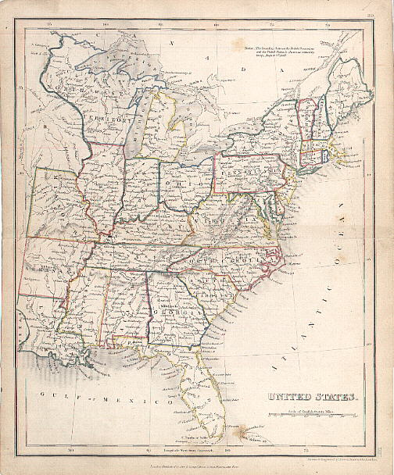
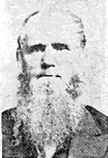
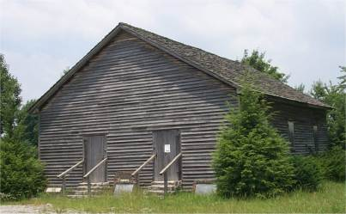
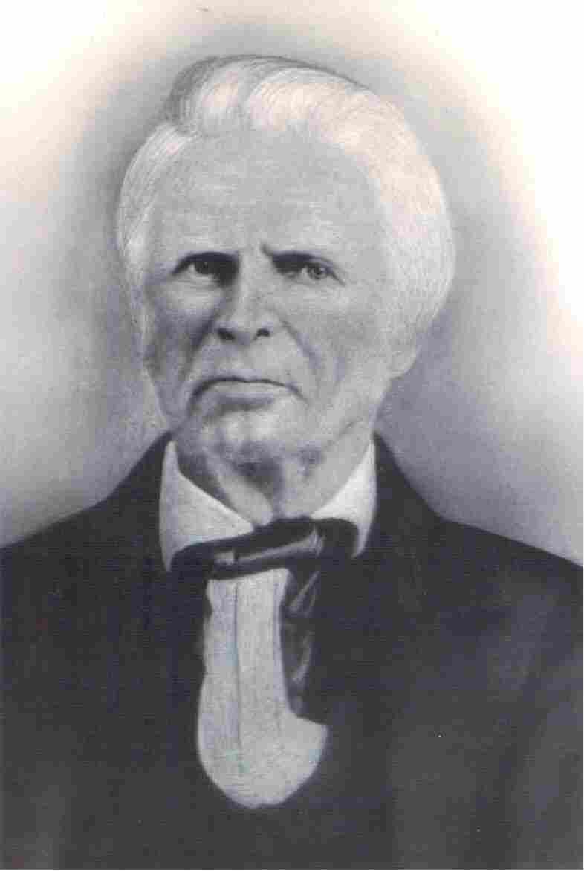
Movements Independent Of Stone & Campbell Part II
Old Philadelphia
Warren Cty. TN
Dr. Chester Bullard
1809-1893
1805
John Taylor
Christian H. Dasher
1807-1895
1789-1866

Slide 14
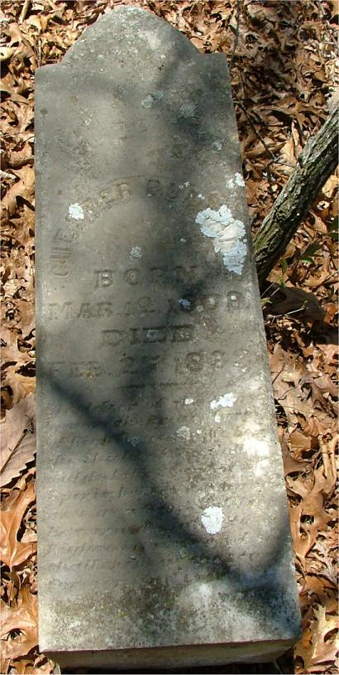
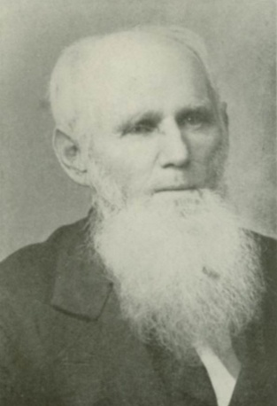
A Virginia Movement
Born In Massachusetts In 1809
Early Influence Of Methodists Who Taught One Must Have A Holy Spirit Experience
His Study Found H. Sp. Worked Only Through The Word Of God
Baptized By Landon Duncan Dec. 11, 1830
1831 Medical Studied, Became A Doctor
Preached His 1st Sermon On Baptism
Organized A Church After The Ancient Order In Catawba, Craig County, 1833
By 1836 He Had Planted Six Churches
Followers Called Bullardites
Moved to Snowville, Montgomery County, Snowville Church Became Known As “Little Jerusalem” Of S.W. Virginia
Never Heard Of The Campbells Until 1839 Finding Their Teaching Similar To His
Preached 60 Years & Baptized 8000-10,000
Dr. Chester Bullard
1809-1893

Slide 15
An Alabama Movement Before 1826
Alabama Became A State In 1819
He Was Reared In The Baptist Faith
Had Trouble With Scripture & Baptist Doctrine
He Wanted To Be Baptized For Remission Of Sins
Found A Baptist Minister Who Nervously Consenting To Baptize Him For Remission Of Sin
Began Preaching After The Ancient Order In Lauderdale/Colbert /Franklin Counties, Alabama
Never Heard Of Alexander Campbell
Said He Found His Doctrine From The Word Of God
John Taylor
1807-1895

Slide 16
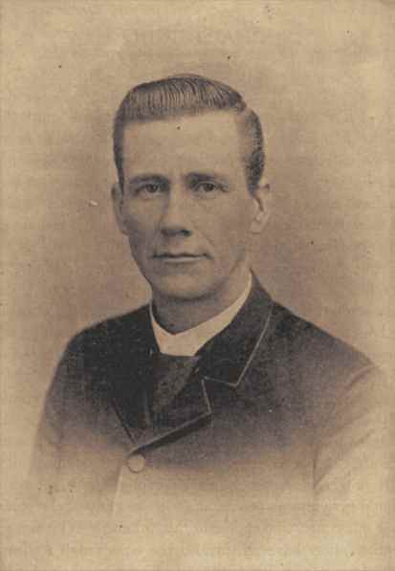
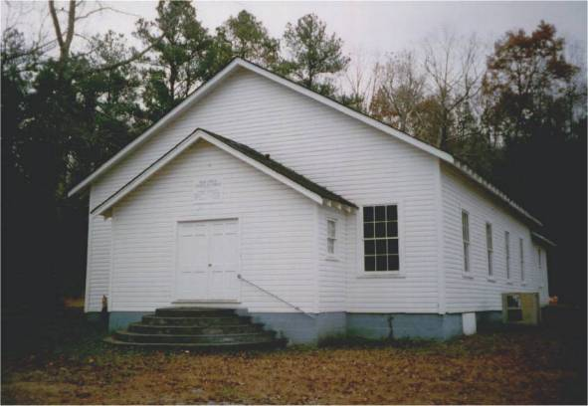
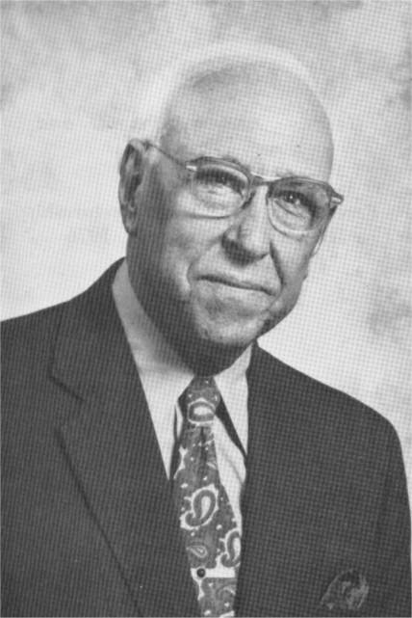
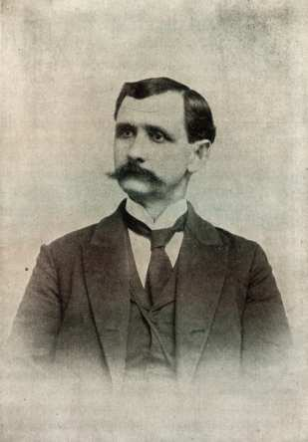
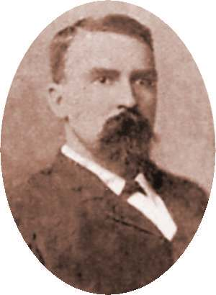
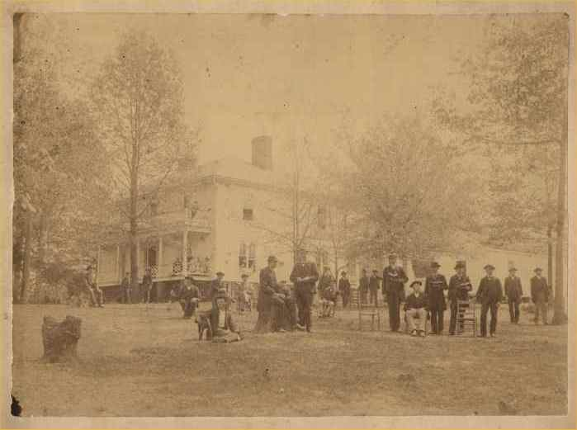
The Influence Of John Taylor
Rock Creek Church Of Christ
Gus Nichols
T.B. Larimore
Near Russellville, Alabama
1892-1975
1843-1929
Mars Hill Bible College
F.D. Srygley
F.B. Srygley
1859-1940
1856-1900
Florence, Alabama 1871-1887

Slide 17
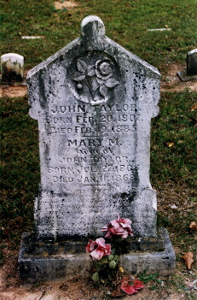
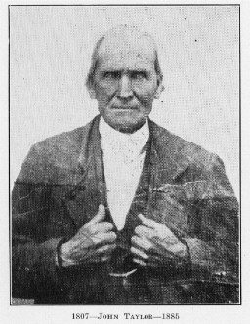
John Taylor Born: Feb. 20, 1807 Died Feb. 19, 1885 Mary M. wife of John Taylor Born Jul. 27, 1808 Died Jan. 11, 1868 In great poverty and through bitter persecution John Taylor Preached the Gospel in Ala. and Miss. from 1830 to the time of his death. This stone is erected by his brethren of the Lord as a token of their appreciat- ion of his labors as a Father and Minister in the Church of Christ

Slide 18
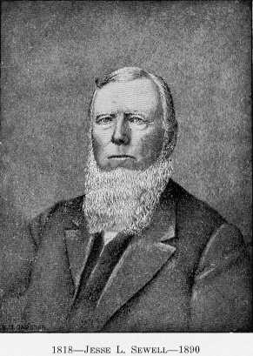
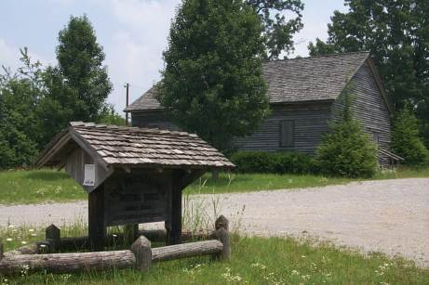
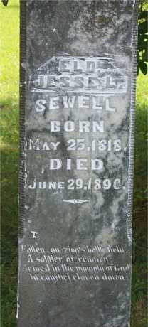
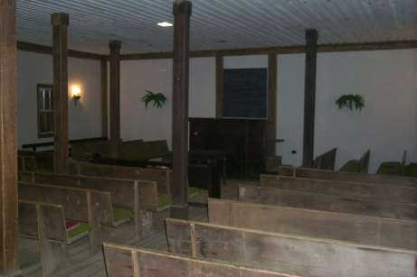
Old Philadelphia, Viola, Tennessee
Jesse L. Sewell
1818-1890

Slide 19
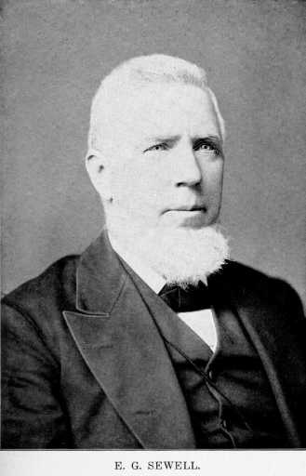
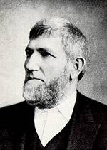
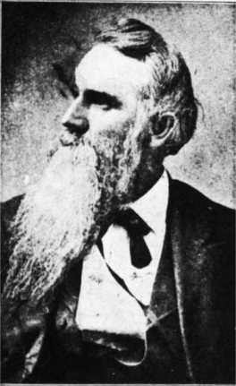
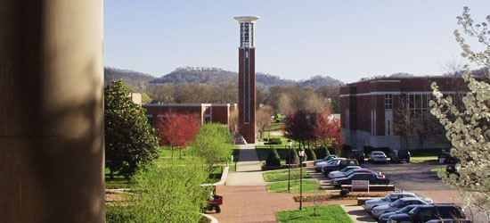
Those Influenced By Jesse Sewell
Jesse L. Sewell
1818-1890
David Lipscomb
Elisha G. Sewell
William Lipscomb
Lipscomb University

Slide 20
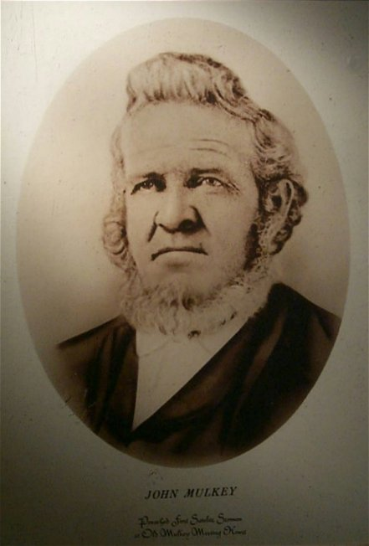
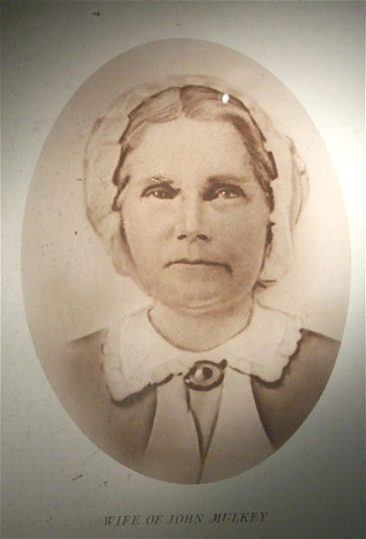
The Work And Influence Of John & Elizabeth Mulkey
Tompkinsville, Kentucky

Slide 21
John Mulkey Tompkinsville, KY 1809
Mill Creek Baptist Church, Near Tompkinsville, Kentucky
John Mulkey, From A Family Of Baptist Preachers, Father Jonathon, Brother Philip
While Preaching From John 10:28 Closed His Bible And Said He Could No Longer Preach Calvinism
He Went Out One Door Of The Building Into The Snow, 2/3 Of Congregation Followed
He Did Not Originally Intend To Restore N.T. Christianity When He Walked Out.
Later He Joined Forces With Barton W. Stone & Others In The “Christian” Movement
Said That In The 53 Years Of His Ministry He Preached 10,000 Sermons And Baptized As Many People

